Slide 1
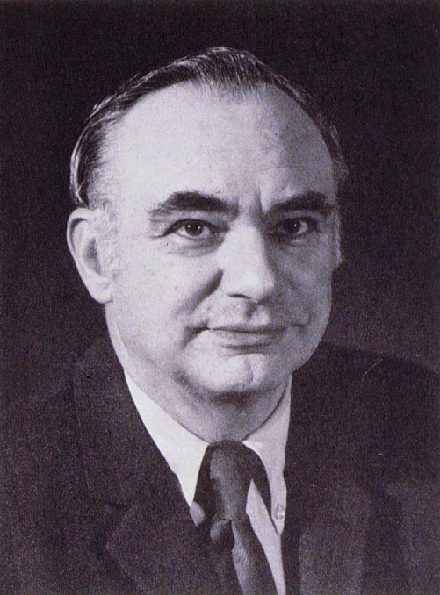
Kenneth T. Whitby Award
American Association for Aerosol Research

Slide 2
Kenneth T. Whitby Award
This award honors Kenneth T. Whitby, known for his contributions to aerosol measurement, the study of aerosol properties and behavior, and the nature of atmospheric aerosols.
The Kenneth T. Whitby Award
“Recognizes outstanding technical contributions to aerosol science and technology by a young scientist. The purpose of the award is to encourage continued work in the field and ongoing support of such endeavors.”
American Association for Aerosol Research

Slide 3
2021 Recipient of the Kenneth T. Whitby Award
Dr. Jason D. Surratt is professor at the University of North Carolina (UNC) at Chapel Hill with joint appointments in Environmental Science and Engineering and Chemistry
“Since 2010, he has published 120 peer-reviewed papers covering fundamental gas and particle-phase chemistry of isoprene and its products, health impacts of organic species, and more recently, airborne per- and polyflouroalkyl substances (PFAS).”
“Jason has shown the field that we can understand these complex reaction systems through dedicated analytical chemistry developments, leveraging synthetic organic chemistry advances to produce reactant materials for laboratory studies, conducting controlled experiments for hypothesis testing and exploration of relevant phase spaces in the laboratory, and top-down assessments using detailed field observations. Fifteen years ago, a research group might focus on one or two of these elements, but Jason showed the power of using all of them for a specific atmospheric aerosol problem.”
Dr. Jason Surratt
American Association for Aerosol Research

