Slide 1
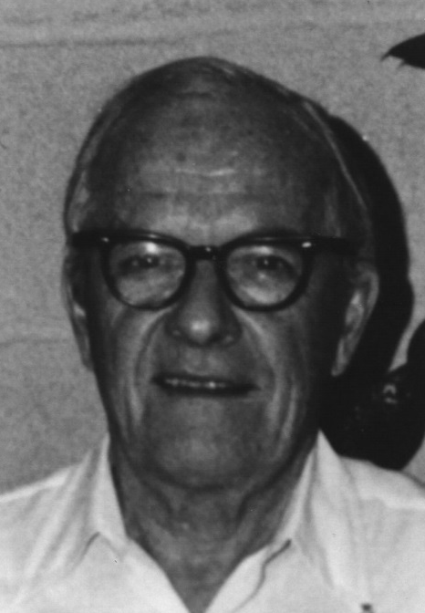
David Sinclair Award
American Association for Aerosol Research

Slide 2
This award memorializes David Sinclair, one of aerosol science’s great innovators, known for his knowledge, ingenuity and energy.
The David Sinclair Award
“recognizes sustained excellence in aerosol research and technology by an established scientist still active in his/her career. The individual’s research must have a lasting impact in aerosol science.”

Slide 3
2016 Recipient of the David Sinclair Award
Spyros Pandis
Carnegie Mellon University
Spyros Pandis has made pioneering contributions to the understanding and amelioration of air pollution. His groundbreaking research has included laboratory measurements, in situ field studies, and atmospheric modeling of transport and chemistry associated with ozone and particulate matter formation.
He has made fundamental contributions to the complex thermodynamics of both inorganic and organic phase partitioning in multiphase atmospheric systems.
He has led two major international air pollution field studies: the 2001-2 EPA/DOE funded Pittsburgh Air Quality Study (PAQS), a $7.5M field study focusing on the role of aerosols in regional air quality, and the 10-million Euro 2012-3 Pan-European Gas-Aerosol-Climate Interactions Study (PEGASOS), with 30 groups from 18 countries in Europe.

