Slide 1
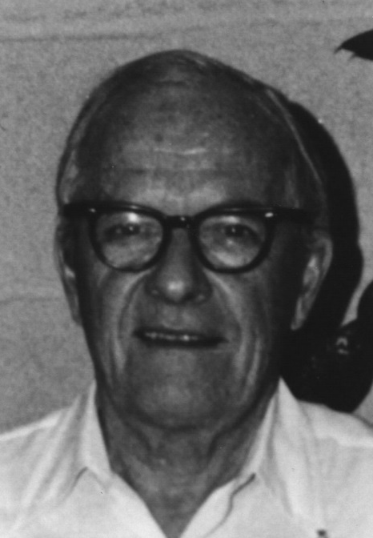
David Sinclair Award
American Association for Aerosol Research

Slide 2
David Sinclair Award
This award memorializes David Sinclair, one of aerosol science’s great innovators, known for his knowledge, ingenuity and energy.
The David Sinclair Award
“Recognizes sustained excellence in aerosol research and technology by an established scientist still active in his/her career. The individual’s research must have a lasting impact in aerosol science.”
American Association for Aerosol Research

Slide 3
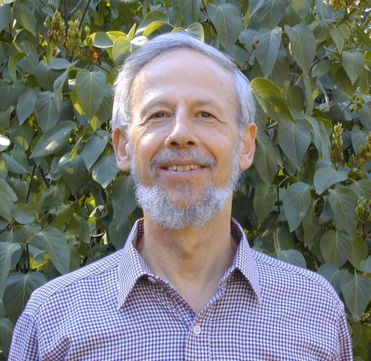
2021 Recipient of the David Sinclair Award
Peter Buseck holds the position of Regents Professor in the Schools of Earth and Space Exploration and Molecular Science at Arizona State University
“… nominated for his pioneering and continuing research on atmospheric aerosols with a focus on the properties of individual particles” using the electron microprobe and electron microscopy
“if one examines his published record from 1966 until present it is clear that there is one home run paper after another that is set up by a combination of intellectual breadth, where he recognizes some very new area where there is an important problem to be attacked, and he develops a new analytical analysis..”
“What he and his group found were that many solid atmospheric particles had irregular shapes and consisted of multiple phases, reminiscence of complex rocks, but on a submicrometer scale. No longer could we assume that particles were idealized spheres of single composition. This, of course, added great complexity to atmospheric models relevant to air quality and climate, but will also lead us to models that are more accurate representations of the truth.”
Peter Buseck
American Association for Aerosol Research

