Slide 1
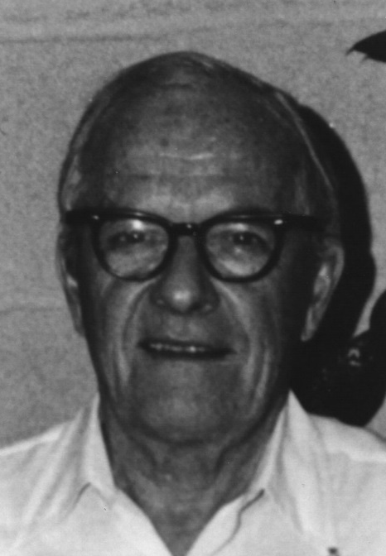
David Sinclair Award
American Association for Aerosol Research

Slide 2
This award memorializes David Sinclair, one of aerosol science’s great innovators, known for his knowledge, ingenuity and energy.
The David Sinclair Award
“recognizes sustained excellence in aerosol research and technology by an established scientist still active in his/her career. The individual’s research must have a lasting impact in aerosol science.”

Slide 3
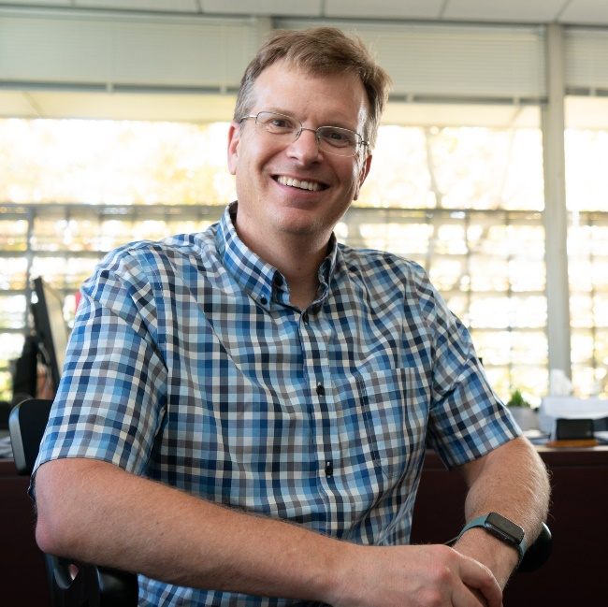
2020 Recipient of the David Sinclair Award
Allen Robinson
Carnegie Mellon University
Dr. Robinson is the Raymond J. Lane Distinguished University Professor and David and Susan Head of the Department of Mechanical Engineering at Carnegie Mellon University.
He has published more than 200 peer-reviewed papers on air quality, climate and health impacts of energy systems with a focus on emissions and atmospheric aerosols – and over 13,000 citations with an H-index of 64.
Among many achievements, Dr. Robinson is well known for his seminal research on semi-volatile emissions and photochemical aging.
He is a fellow and former president of the American Association of Aerosol Research (AAAR).
“Allen’s work has changed the way we look at organic aerosol emissions into the atmosphere.”

