Slide 1

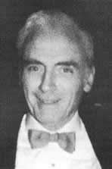
Thomas T. Mercer Joint Prize
American Association for Aerosol Research

Slide 2
This award honors the legacy of Thomas T. Mercer, an outstanding researcher and author whose work encompassed aerosol physics and chemistry as well as inhalation toxicology, industrial hygiene, and health physics.
The Thomas T. Mercer Joint Prize
“excellence in the areas of pharmaceutical aerosols and inhalable materials.”

Slide 3

2015 Recipient of the
Thomas T. Mercer Joint Prize
Omar Sharif Usmani
Imperial College London
Major research interests are in Asthma, COPD and Cough
Research has fundamentally altered our understanding of therapeutic aerosol deposition and clinical effectiveness in inhaled pulmonary drug delivery.
His novel work on deposition led him to identify physiological markers of airway responses related to targeting inhaled therapy to small and large airways.
His novel work on deposition led him to identify physiological markers of airway responses related to targeting inhaled therapy to small and large airways.

