Slide 1
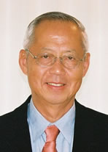
Benjamin Y. H. Liu Award
American Association for Aerosol Research

Slide 2
The award honors Professor Benjamin Liu for his leadership in the aerosol community and his own seminal contributions to aerosol science through instrumentation and experimental research.
The Benjamin Y. H. Liu Award
“Recognizes outstanding contributions to aerosol instrumentation and experimental techniques that have significantly advanced the science and technology of aerosols.”

Slide 3
2015 Recipient of the Benjamin Y. H. Liu Award
Mark R. Stolzenburg
University of Minnesota
Has contributed more to aerosol instrumentation than almost any other aerosol scientist.
Developed the first condensation particle counter (CPC) that enabled measurements in the 3nm size range.
Co-inventor of the laminar flow, water-based condensation particle counter.
Even more than the instruments themselves, his analytical models have advanced the understanding of those instruments, and enabled others to take his developments even further

