Slide 1
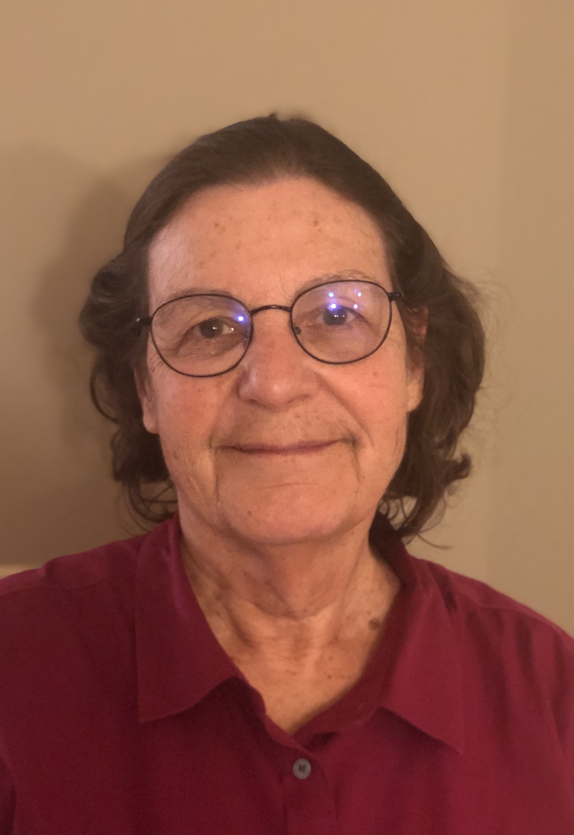
Susanne V. Hering Award
American Association for Aerosol Research

Slide 2
Susanne V. Hering Award
This award honors Susanne V. Hering, who is well known for her development of innovative measurement instrumentation, and for her efforts to build AAAR in to a vibrant, sustainable community for aerosol scientists.
The Susanne V. Hering Award
“Recognizes outstanding contributions to aerosol science. The purpose of the award is to recognize accomplishments and encourage further research in the field of aerosol science with special emphasis on work that has had a significant impact on public health, the built environment, or the global ecosystem.
American Association for Aerosol Research

Slide 3
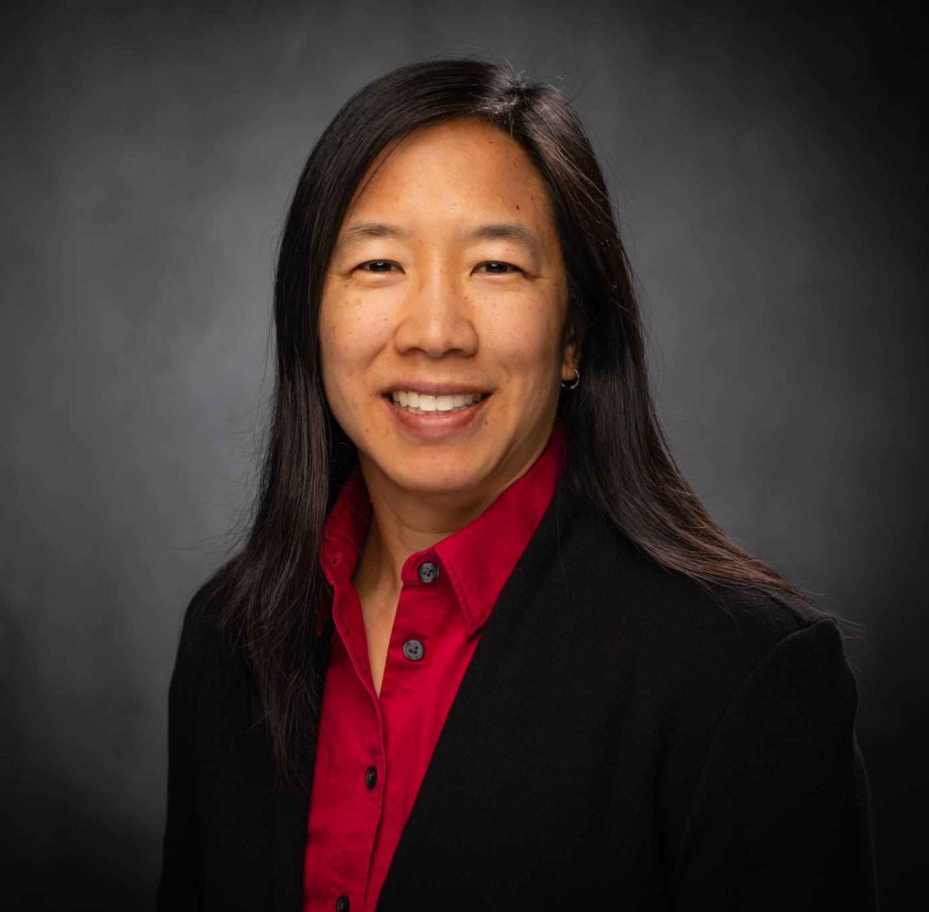
2021 Recipient of the Susanne V. Hering Award
Linsey Marr is the Charles P. Lunsford Professor of Civil and Environmental Engineering at Virginia Tech.
“No one better manifests the spirit of this award than Prof. Linsey Marr. Throughout her stellar career, Prof. Marr excelled in not one, but in two of these areas: public health and the built environment. “
“She was prepared to take a prominent role in the education of
policy makers, the care givers, and the public about the importance of aerosols in transmission of COVID-19 because she began asking key questions about transport of viruses, both in the indoor environment and long-range transport in the global environment, and built a research program in an area that had received little attention.“
“Together, her research and outreach have had a significant impact on public health during the current global pandemic.“
Linsey Marr
American Association for Aerosol Research

