Slide 1

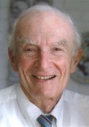
Sheldon K. Friedlander Award
American Association for Aerosol Research

Slide 2
This award honors professor Sheldon Friedlander for his leadership as a researcher, teacher and pioneer in aerosol science.
The Sheldon K. Friedlander Award
“recognizes an outstanding dissertation by an individual who has earned a doctoral degree. The dissertation can be in any discipline in the physical, biomedical or engineering sciences but has to be in a field of aerosol science and technology.”

Slide 3
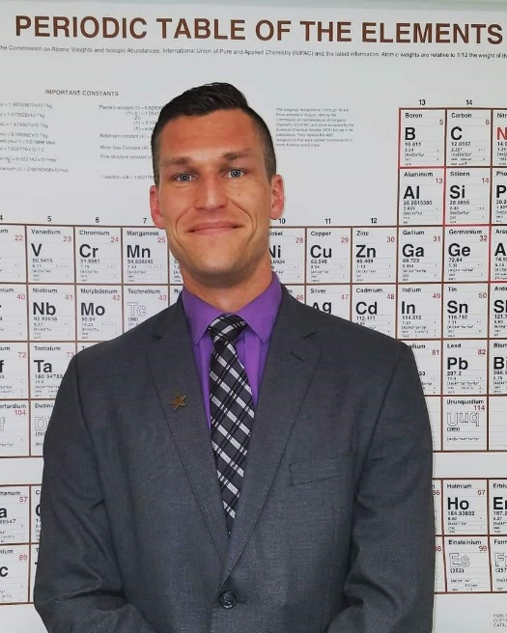
2020 Recipient of the
Sheldon K. Friedlander Award
James Corson
United States Nuclear Regulatory Commission
James Corson earned a Ph.D. in chemical engineering from the University of Maryland.
He is currently involved in research related to nuclear fuel behavior during normal reactor operations and during severe reactor accidents, including the transport of radioactive vapors and aerosols to the environment.
Dissertation Title: “Predicting The Transport Properties Of Aerosol Particles In Creeping Flow From The Continuum To The Free Molecular Regime”
“…most PhDs do not make such seminal, and potentially timeless contributions during their doctoral studies and it will likely be another decade or two before another equally strong theoretical treatise is published by a recent PhD in aerosol science”

