Slide 1
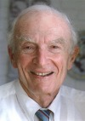
The Sheldon K. Friedlander Award
American Association for Aerosol Research

Slide 2
This award honors professor Sheldon Friedlander for his leadership as a researcher, teacher, and pioneer in aerosol science.
The Sheldon K. Friedlander Award “recognizes an outstanding dissertation by an individual who has earned a doctoral degree. The dissertation can be in any discipline in the physical, biomedical, or engineering sciences but has to be in a field of aerosol science and technology”.

Slide 3
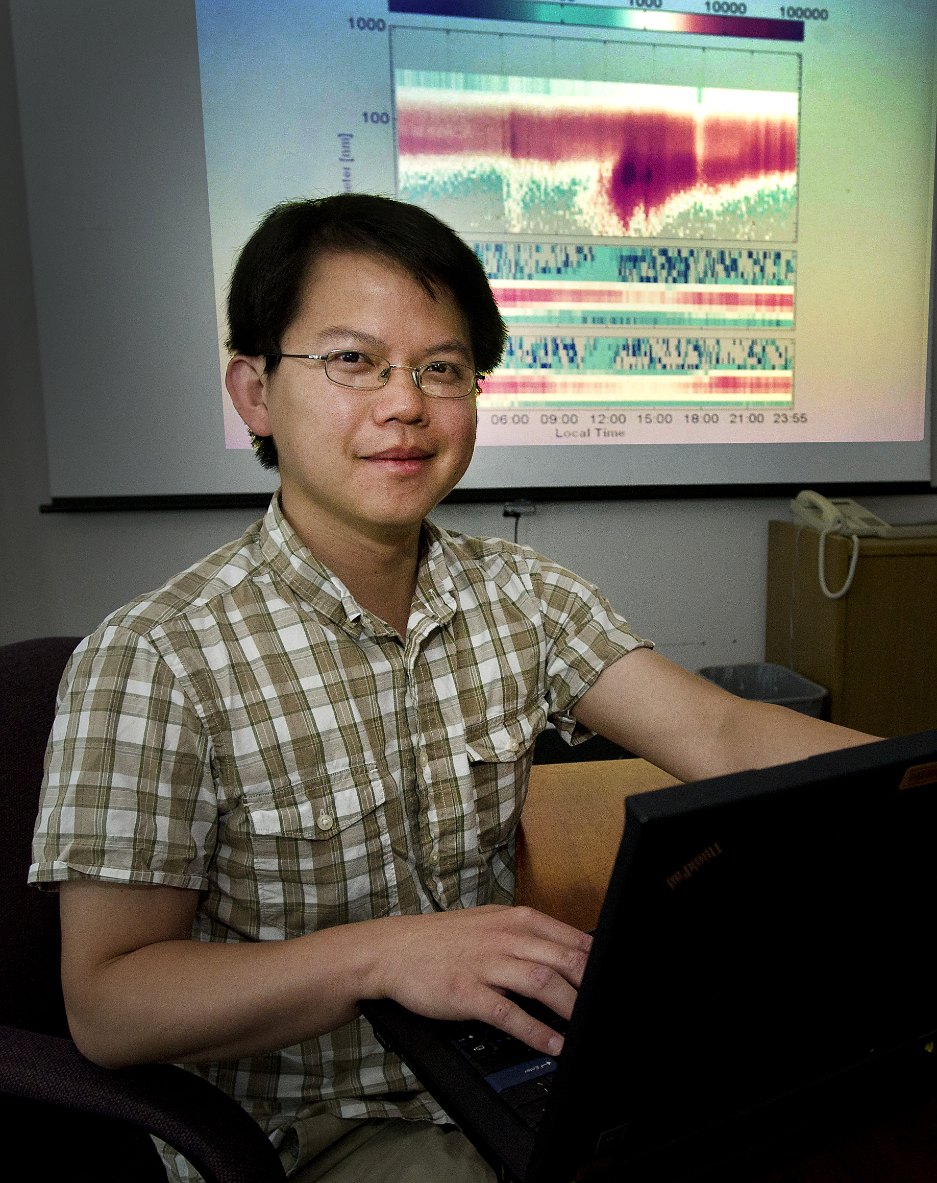
2012 Recipient of the Sheldon K. Friedlander Award
Chongai Kuang
Brookhaven National Laboratory
Nominated by his PhD co-advisor Prof. Peter McMurry, University of Minnesota, Minneapolis
Ph.D., 2009, Chemical Engineering, with a minor in Nanoparticle Science and Technology, University of Minnesota, Minneapolis
Ph.D. thesis title: “Atmospheric Nucleation: Measurements, Mechanisms, and Dynamics”
Focus on fundamental factors that influence rates of new particle formation in the atmosphere
“a first-rate mathematician, a fine experimentalist, a skillful analyst and an excellent communicator…”
“his research contributions nicely combine an elegant, theoretical description of the key processes with much-needed observational constraints”
“…one of the most accomplished and talented young aerosol scientists in the world.”

