Slide 1
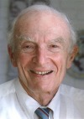
The Sheldon K. Friedlander Award
American Association for Aerosol Research

Slide 2
This award honors professor Sheldon Friedlander for his leadership as a researcher, teacher, and pioneer in aerosol science.
The Sheldon K. Friedlander Award “recognizes an outstanding dissertation by an individual who has earned a doctoral degree. The dissertation can be in any discipline in the physical, biomedical, or engineering sciences but has to be in a field of aerosol science and technology”.

Slide 3
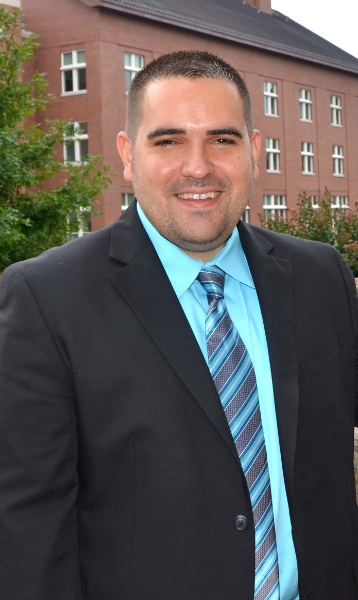
2013 Recipient of the Sheldon K. Friedlander Award
Jason Surratt
University of North Carolina
PhD., 2010, Chemistry, California Institute of Technology
PhD. dissertation title: “Analysis of the Chemical Composition of Atmospheric Organic Aerosols by Mass Spectrometry ”
Focused on the chemical characterization of secondary organic aerosol formed under high- and low-NOx conditions.
“… the first to clearly show that organic aerosol formation from the oxidation of a-pinene and isoprene under varying NOx conditions leads to organosulfates in ambient aerosol.“
“By bringing new analytical techniques and insights, he has made substantive contributions to understanding the fate of isoprene in the clean and polluted atmosphere.”
“… pushing the envelope in science, measurement technology, carefully planned laboratory studies, and field observations.”
“…one of the world leaders in measurements of the chemical composition of organic aerosol…”

