Slide 1
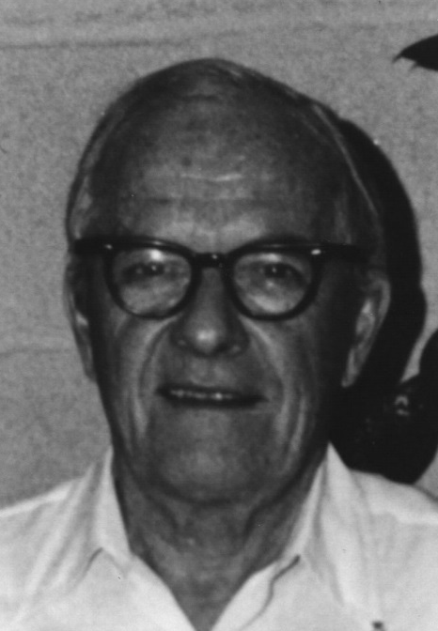
David Sinclair Award
American Association for Aerosol Research

Slide 2
This award memorializes David Sinclair, one of aerosol science’s great innovators, known for his knowledge, ingenuity and energy.
The David Sinclair Award
“recognizes sustained excellence in aerosol research and technology by an established scientist still active in his/her career. The individual’s research must have a lasting impact in aerosol science.”

Slide 3
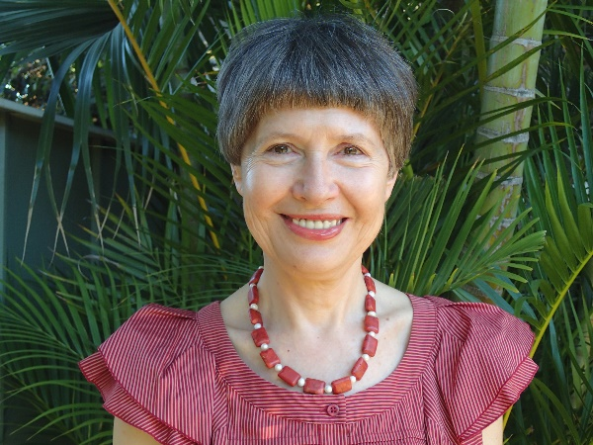
2017 Recipient of the David Sinclair Award
Lidia Morawska
Queensland University of Technology
Author of more than 700 publications, many invited key note presentations and plenary lectures.
Substantial contributions in the field of atmospheric particulate matter, its sources and impact upon human health and the environment.
Professor Morawska did some of the first studies on spatial and temporal distribution of vehicle emissions in urban microenvironments.
In 1992, she established the International Laboratory for Air Quality and Health (ILAQH) at QUT. Since 2004 ILAQH has been a Collaborating Centre of the WHO on Research and Training in the field of Air Quality and Health. She is a co-director of the Australia-China Centre for Air Quality Science and Management.
Professor Morawska serves as advisor on numerous high profile Australian and international projects, committees and advisory boards. She took organizational and scientific leadership in the UPTECH study, which seeks to determine the effect of the exposure to airborne fine and ultrafine particles emitted from motor vehicles on the health of children in schools.
Professor Morawska is recognized as an outstanding personality. She is a distinguished member of the scientific community and exceptional lecturer.

