Slide 1

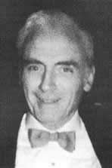
Thomas T. Mercer Joint Prize
American Association for Aerosol Research

Slide 2
This award honors the legacy of Thomas T. Mercer, an outstanding researcher and author whose work encompassed aerosol physics and chemistry as well as inhalation toxicology, industrial hygiene, and health physics.
The Thomas T. Mercer Joint Prize
“excellence in the areas of pharmaceutical aerosols and inhalable materials.”

Slide 3
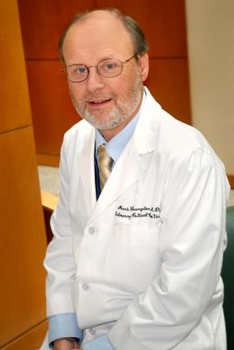
2020 Recipient of the
Thomas T. Mercer Joint Prize
Mark Frampton
University of Rochester Medical Center
Dr. Frampton is Professor Emeritus in Medicine in the Pulmonary & Critical Care Division.
Research has focused on the health effects of air pollution using human clinical exposure studies including a recent large study addressing the cardiovascular effects of ozone exposure in healthy older subjects.
Active on many federal advisory panels and grant review study sections
“His work combining aerosol characterization and human inhalation exposures with clinical measures to address problems of environmental and occupational aerosol exposures are in the spirit of Thomas T. Mercer’s legacy of using basic and applied science to prevent potential adverse effects of inhaled particles.”

