Slide 1

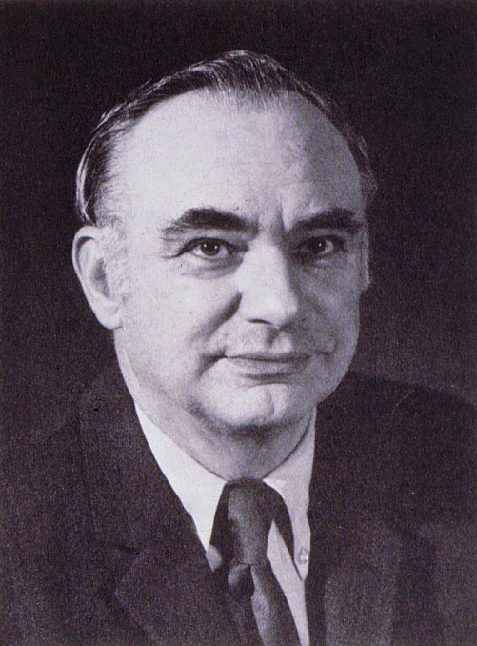
Kenneth T. Whitby Award
American Association for Aerosol Research

Slide 2
This award honors Kenneth T. Whitby, known for his contributions to aerosol measurement, the study of aerosol properties and behavior, and the nature of atmospheric aerosols.
The Kenneth T. Whitby Award
“recognizes outstanding technical contributions to aerosol science and technology by a young scientist. The purpose pf the award is to encourage continued work in the field and ongoing support of such endeavors.”

Slide 3

2019 Recipient of the
Kenneth T. Whitby Award
Rajan Chakrabarty
Washington University in St. Louis
  Ph.D. in Chemical Physics from University of Nevada, Reno with dissertation research at Desert Research Institute
  Currently Assistant Professor in the Department of Energy, Environmental & Chemical Engineering at Washington University in St. Louis
  Over 70 peer-reviewed publications (46 papers since 2014) and 3 patents
  “body of work is without peer in the aerosol community at mid-career”
  “… soup-to-nuts characterization of light absorbing carbonaceous aerosol involving laboratory and field measurements and a healthy dose of first-rate optical physics”
  “Addressed two long-standing problems: the ballistic-to-diffusive transition in non-thermally driven systems, and aerosol-to-gel kinetics…”
  “Invented a flame-based continuous aerosol gel synthesis technique” and “a technique to classify particle morphology using electrostatic classifiers”

