Slide 1

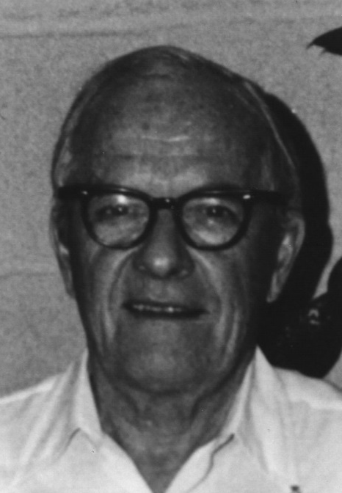
David Sinclair Award
American Association for Aerosol Research

Slide 2
This award memorializes David Sinclair, one of aerosol science’s great innovators, known for his knowledge, ingenuity and energy.
The David Sinclair Award
“recognizes sustained excellence in aerosol research and technology by an established scientist still active in his/her career. The individual’s research must have a lasting impact in aerosol science.”

Slide 3
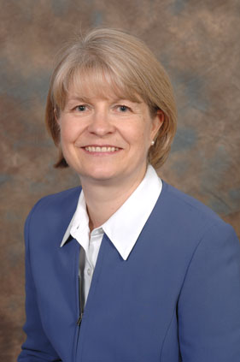
2019 Recipient of the
David Sinclair Award
Tiina Reponen
University of Cincinnati
Dr. Reponen, Professor of Environmental Health of the University of Cincinnati, is widely respected worldwide for her pioneering studies in biological aerosols. Trained as an environmental scientist in Finland and the USA, she has conducted various studies on the aerosolization, measurement, and characterization of bioaerosol particles, including bacteria, fungi, pollen and microbial fragments.
Her seminal work on bioaerosol characterization paved the road to the development of several innovative techniques for generation and collection of bioaerosol particles. She applied her findings to the assessment of the human exposure to airborne microorganisms, which generated a crucial knowledge about specific particle characteristics linked to health effects.
She has published over 200 peer-reviewed papers and advised dozens of graduate students. Dr. Reponen’s contributions have had a substantial impact on the research programs of the National Institute for Occupational Safety and Health (NIOSH), National Institute for Environmental Health Sciences (NIEHS), US EPA, and other agencies nationally and internationally.
Her leadership in the bioaerosol field is broadly recognized in research communities specializing in aerosol science and technology, indoor air quality, environmental health and aerobiology. She has served as an Editor of the Aerosol Science and Technology, a member of the AAAR Board of Directors, and the chair of several AAAR committees.

