Slide 1

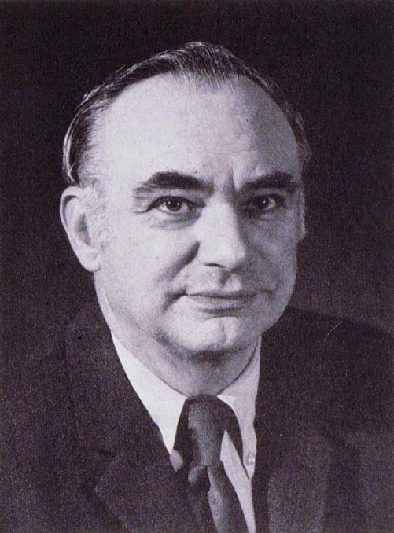
Kenneth T. Whitby Award
American Association for Aerosol Research

Slide 2
This award honors Kenneth T. Whitby, known for his contributions to aerosol measurement, the study of aerosol properties and behavior, and the nature of atmospheric aerosols.
The Kenneth T. Whitby Award
“recognizes outstanding technical contributions to aerosol science and technology by a young scientist. The purpose of the award is to encourage continued work in the field and ongoing support of such endeavors.”

Slide 3

2018 Recipient of the
Kenneth T. Whitby Award
Chris Hogan
University of Minnesota
Recognized for outstanding contributions as an experimentalist, modeler, and theorist to the study of aerosol physics and chemistry. Published 84 refereed journal publications with >3000 citations to date.
Developed a mean first passage time Brownian dynamics technique, yielding algebraic dimensionless expressions for collision rates between particles, applicable to particles of different shapes and size regimes.
Utilized high resolution differential mobility analysis-MS to examine aerosol cluster structure and the binding of vapor molecules to clusters.
Developed a drift tube ion mobility spectrometer with CPC detector for nanoparticle size distribution measurements, an electrospray analyzer for aerosol particle MS, and data inversion techniques for tandem mobility-mass analysis.
Chris received his PhD from Washington University in 2008; his dissertation was recognized with the 2011 Friedlander Award. After a postdoc at Yale, Chris joined the Mechanical Engineering faculty at Minnesota where he is now Associate Professor and Director of Graduate Studies.

