Slide 1

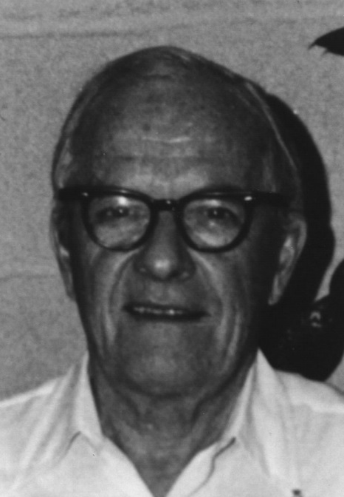
David Sinclair Award
American Association for Aerosol Research

Slide 2
This award memorializes David Sinclair, one of aerosol science’s great innovators, known for his knowledge, ingenuity and energy.
The David Sinclair Award
“recognizes sustained excellence in aerosol research and technology by an established scientist still active in his/her career. The individual’s research must have a lasting impact in aerosol science.”

Slide 3
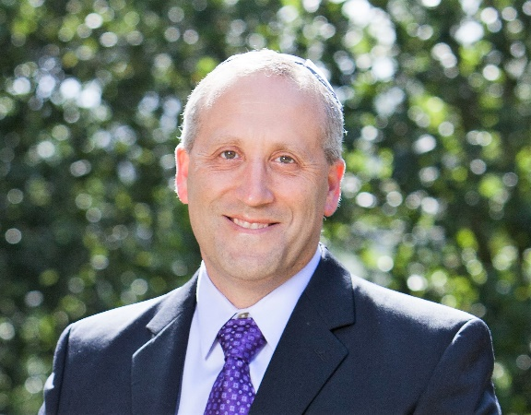
2018 Recipient of the
David Sinclair Award
Allen Goldstein
University of California Berkeley
Recognized for substantial contributions in the field of atmospheric PM, its sources and its impacts upon human health and the environment. Published >300 refereed journal articles with an h-index of 81.
Led numerous advances in our understanding of the organic constituents of atmospheric aerosols – unraveling chemical pathways that control their formation, elucidating interactions between biogenic and anthropogenic emissions, and identifying constituents of primary emissions.
Pioneered new methods for analyzing organic aerosols, including improved measurements of their temporal variability and complex speciation.
Mentored many current and emerging leaders in the field of aerosol chemistry.
Prof. Goldstein received his PhD from Harvard University in 1994. He joined UC Berkeley in 1996 where he holds faculty appointments in the Departments of Environmental Science, Policy and Management and Civil and Environmental Engineering and at Lawrence Berkeley National Laboratory.

