Slide 1

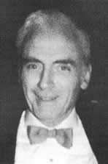
Thomas T. Mercer Joint Prize
American Association for Aerosol Research
International Society for Aerosols in Medicine

Slide 2
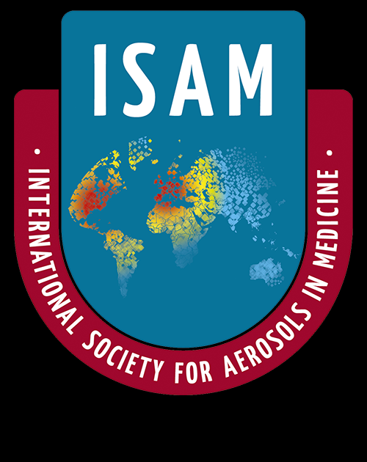
This award honors the legacy of Thomas T. Mercer, an outstanding researcher and author whose work encompassed aerosol physics and chemistry as well as inhalation toxicology, industrial hygiene, and health physics.
The Thomas T. Mercer Joint Prize recognizes
“excellence in the areas of pharmaceutical aerosols and inhalable materials.”

Slide 3
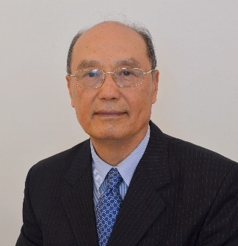
2018 Recipient of the
Thomas T. Mercer Joint Prize
Chong S. Kim
Environmental Public Health Division
National Health and Environmental Effects Research Laboratory
U. S. Environmental Protection Agency
For over 35 years Dr. Kim has endeavored to advance the field of inhaled aerosol dosimetry. After a PhD at Minnesota, he joined the Mount Sinai Medical Center then USEPA where he is currently team leader of the Inhalation Dosimetry Program at the National Health and Environmental Effects Research Laboratory.
Pioneered studies in aerosol deposition in patients with obstructive airway disease, systematically measured total and regional lung deposition of aerosols in men, women, young and old subjects, constructed a ground-breaking empirical model of total lung deposition for any particle size and breathing pattern, developed validated computational models for providing micro-dose information relevant to human and respiratory system tissue and cellular exposure, and more.
Dr. Kim, a AAAR Fellow, has published >100 peer reviewed articles on aerosol inhalation, transport and deposition in the respiratory system and been recognized with numerous awards for his high impact work.

