Slide 1

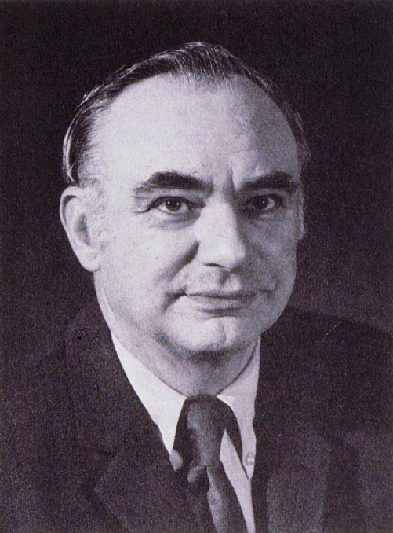
Kenneth T. Whitby Award
American Association for Aerosol Research

Slide 2
This award honors Kenneth T. Whitby, known for his contributions to aerosol measurement, the study of aerosol properties and behavior, and the nature of atmospheric aerosols.
The Kenneth T. Whitby Award
“recognizes outstanding technical contributions to aerosol science and technology by a young scientist. The purpose pf the award is to encourage continued work in the field and ongoing support of such endeavors.”

Slide 3

2016 Recipient of the
Kenneth T. Whitby Award
Nga Lee Ng
Georgia Institute of Technology
Sally Ng’s contributions to aerosol science have been exceptional for a scientist still early in her career.
She has published a significant number of papers that are impressive for their breadth and scientific impact.
Sally has made important contributions to aerosol mass spectroscopy instrumentation and data interpretation and, through both chamber and field experiments, she has advanced current understanding of atmospheric secondary organic aerosol (SOA) formation.

