Slide 1
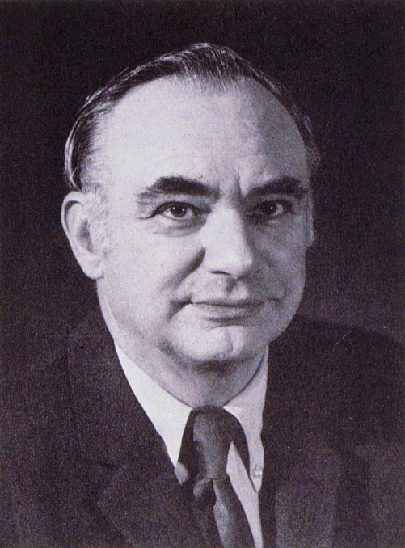
Kenneth T. Whitby Award
American Association for Aerosol Research

Slide 2
This award honors Kenneth T. Whitby, known for his contributions to aerosol measurement, the study of aerosol properties and behavior, and the nature of atmospheric aerosols.
The Kenneth T. Whitby Award
“recognizes outstanding technical contributions to aerosol science and technology by a young scientist. The purpose pf the award is to encourage continued work in the field and ongoing support of such endeavors.”

Slide 3
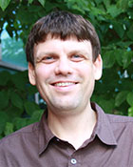
2015 Recipient of the Kenneth T. Whitby Award
Markus Petters
North Carolina State University
Notable contributions to furthering understanding of how atmospheric aerosols interact with water vapor and influence cloud droplet formation.
Developed the theoretical “kappa” framework in collaboration with Dr. Kreidenweis.
58 papers since 2006, an average of 7 papers per year since his PhD.

Slide 4
2015 Recipient of the Kenneth T. Whitby Award
V. Faye McNeill
Columbia University
Research focuses on heterogeneous chemistry of ice and aerosol particles in the atmosphere; in particular, the impact of aerosol‐phase chemistry on light absorption and surface tension.
Her research is changing the way we think about atmospheric organic chemistry, its effect on aerosol properties, and its impact on clouds and climate
39 papers that have been cited over 1100 times, including two in Proceedings of the National Academy of Sciences.

