Slide 1
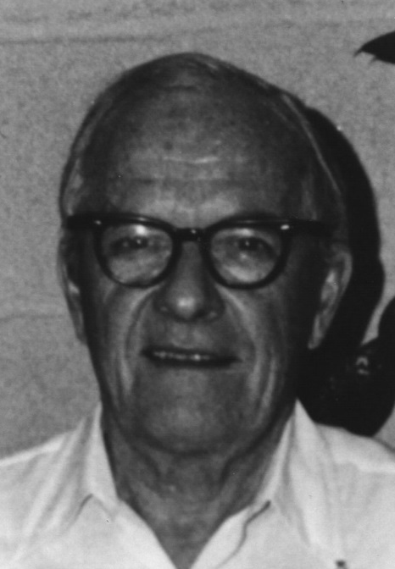
David Sinclair Award
American Association for Aerosol Research

Slide 2
This award memorializes David Sinclair, one of aerosol science’s great innovators, known for his knowledge, ingenuity and energy.
The David Sinclair Award
“recognizes sustained excellence in aerosol research and technology by an established scientist still active in his/her career. The individual’s research must have a lasting impact in aerosol science.”

Slide 3
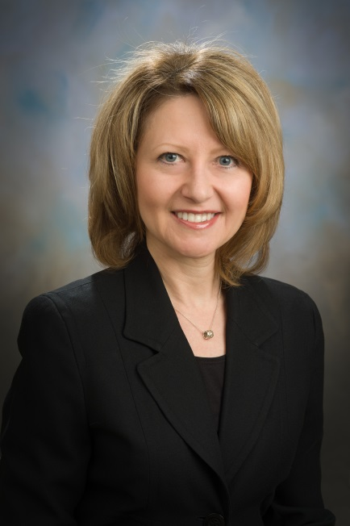
2015 Recipient of the David Sinclair Award
Sonia M. Kreidenweis
Colorado State University
Is internationally recognized for her seminal work in aerosol and cloud physics and chemistry.
Many of her papers are considered “classics” and widely cited.
Publication record is outstanding with nearly 200 peer reviewed publications that have been cited over 8,000 times.
Has also a tremendous impact on the field through major service commitments, e.g., AAAR President, AAAR conference chair, and an outstanding mentor to dozens of graduate students and postdocs.

